Slide 1
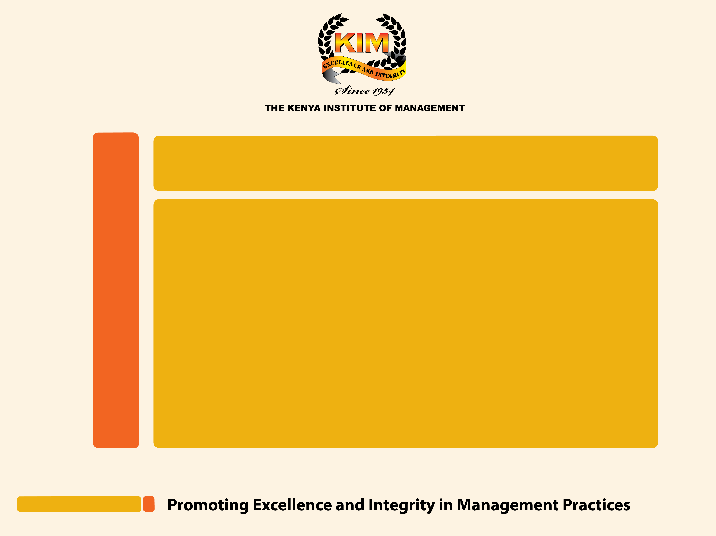
Diversity and Inclusion in the Workplace Presentation by Muriithi Ndegwa, OGW, HSC, Executive Director/CEO, The Kenya Institute of Management
Date: 23th March, 2018

Slide 2
Content
About KIM
Introduction
Global practices
Local practices
Why be concerned about D&I at the workplace
Way forward

Slide 3



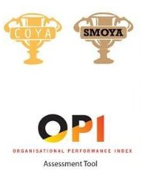
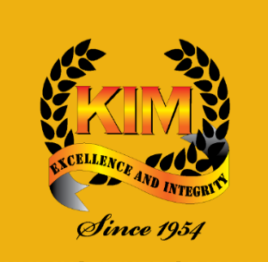
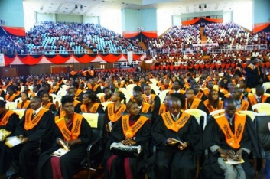


About KIM
Professional membership organization (Est 1954)
21 locations countrywide
Market leader in leadership & management training
Focus areas;
Membership
KIMSOM
BSC
OPI/COYA
Research

Slide 4
Introduction; what is D & I?
What is..
Workplace diversity refers to the variety of differences (gender, age, religion, race, ethnic etc) between people in an organization (Society for Human Resource Management, SHRM).
Workplace inclusion having a balanced representation of the diverse people defined above (SHRM).

Slide 5
Introduction; what is D & I?
Diversity
Male
Young
Inclusion
Old
Buddhist
Asian
Christian
D&I go hand in hand
African
Hindu
Muslim
Latino

Slide 6
Global practices

Slide 7
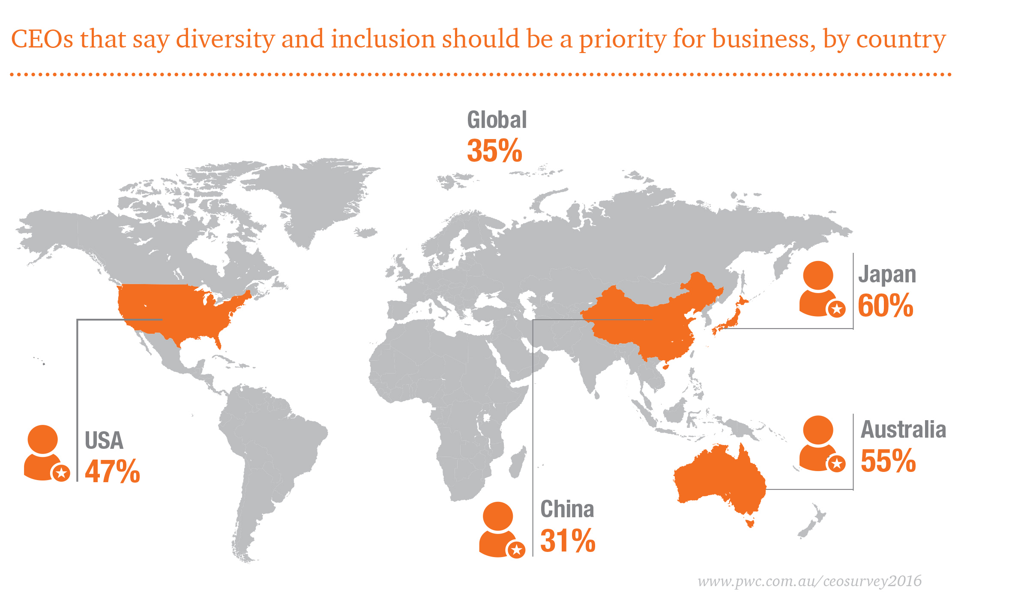
CEO’s accept that D&I is important; more so in Japan than anywhere else
D&I at the workplace are now CEO-level issues, but they continue to be frustrating and challenging for many companies.
Why the gap?
Source: PwC, 2016

Slide 8
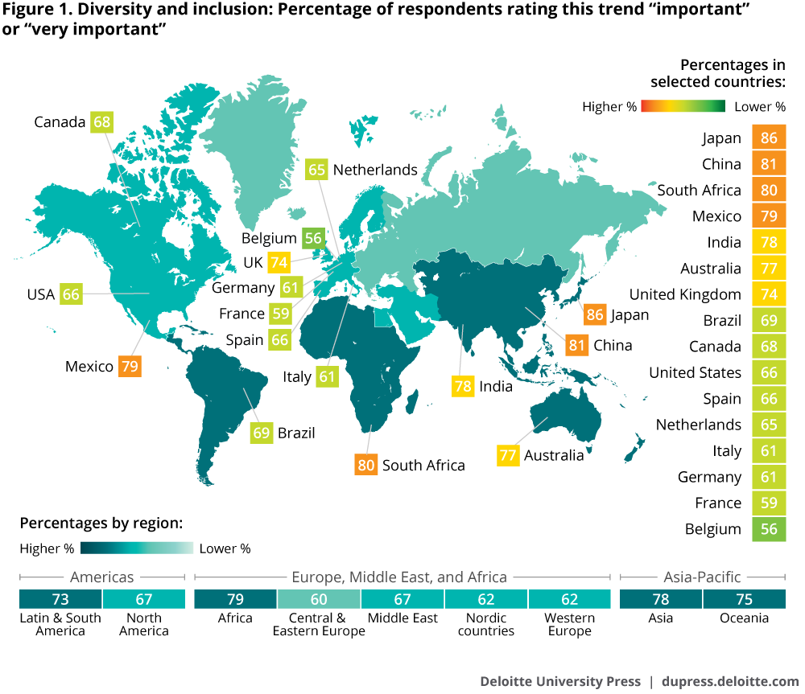
Even employees admit that D&I is important in the workplace globally
% of employees who say D&I is important at the workplace
According to a Deloitte (2017) report;
In 2017, the proportion of executives who cited inclusion as a top priority has risen by 32% compared with a 2014 survey.
Over two-thirds (69%) of executives rate D&I an important issue (up from 59% in 2014).
38% of executives report that the primary sponsor of the company’s D&I efforts is the CEO.
Source: Deloitte, 2017

Slide 9
At the governance level, globally...
Norway has
Since 2008, required listed company in the country to fill at least 40% of directorship positions with women.
UK has since 2010 instituted a Corporate Governance Code
i) Incorporate diversity as a consideration in making board appointments;
(ii) Disclose in annual reports describing the board’s policy on diversity, as well as progress in achieving the objectives of that policy.
Australia and Hong Kong are promoting diversity using a similar 'comply or explain' approach.
International Corporate Governance Network (ICGN)
Spain and France are implementing similar mandatory requirements for gender diversity.
The International Corporate Governance Network (ICGN) encourages the adoption of a policy on diversity which should include measurable targets for achieving appropriate diversity within a company’s senior management and board (both executive and non-executive) and report on progress made in achieving such targets.

Slide 10




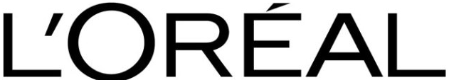


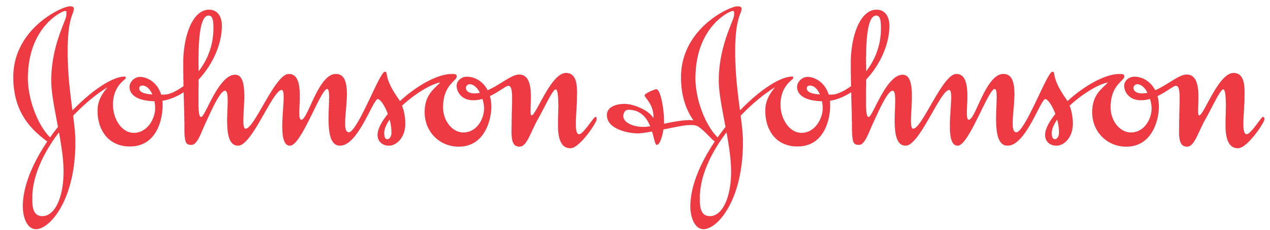
Top Companies globally that are leaders in implementing D&I in the workplace
BASF
Earned A Spot on Diversity Inc.’s Top 50 in 2015, 2014 and 2013.
Ford Motor Company
Sodexo
Received the Catalyst Award in 2012 and earned a spot on Diversity Inc.’s Top 50 on eight different occasions
AIG
L’Oreal
Presented with the Corporate Diversity Innovation Award in 2016 by World Diversity Leadership Council, as well as the DANDI Award in 2012
Deutsche Bank
Made Diversity Inc.’s Top 50 an impressive 11 times
In 2015, AIG earned a spot on Diversity Inc.’s 25 Noteworthy Companies list for the second year in a row
Named as one of the Top 50 Employers for Women, also won an award for its global sponsorship program ATLAS, which helps women progress to senior positions
The global healthcare company was listed on Diversity Inc.’s Top 50 eleven times
Bayer
Named a Top 10 Company for Asian Americans, as well as a Top Global Company by Diversity Inc.
Johnson & Johnson

Slide 11
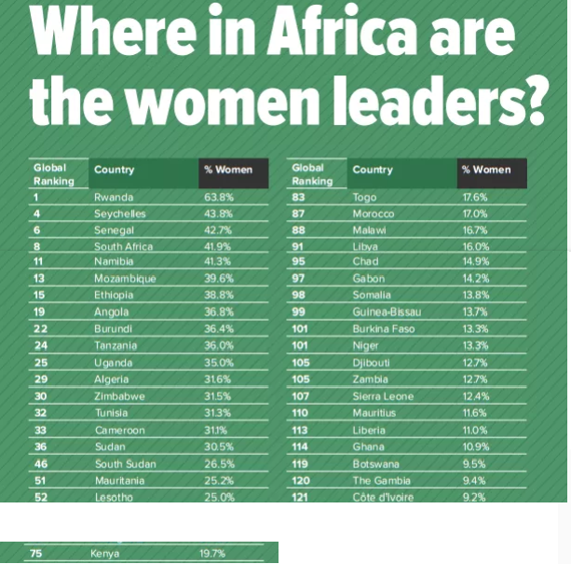
D&I practices in Africa
D&I in Africa mainly encompasses the gender aspect.
Africa is a very tough terrain for women so much so that they have at times been classified as belonging to vulnerable categories (AfDB)
Rwanda, Seychelles, Senegal, & S.A are in top 10 globally.
Kenya ranks 75 in women representation in the legislature
Source: Brookings Institute, 2016

Slide 12
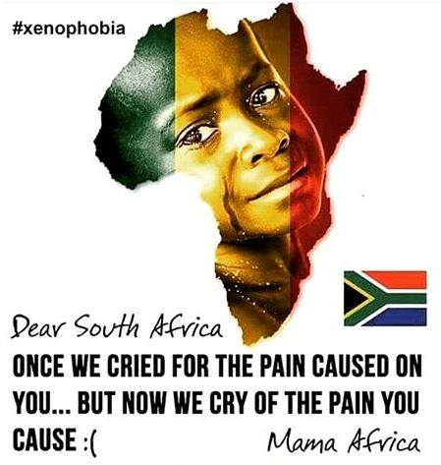
D&I practices in Africa: Focus on South Africa
In S.A., the Apartheid system saw the discrimination of nonwhites both politically and economically.
Since the end of Apartheid, S.A. has upped its efforts to tackle exclusion from mainstream economic and societal activities.
In tandem to this, the country has made sufficient provisions in diversifying the workplace but the country is not there yet.
However, the country seems to be struggling with implementing D&I and the results of that are what we have seen as Xenophobic attacks in the recent years since 2009 – 2017 with no less than 5 attacks in this period.

Slide 13
Local practices

Slide 14
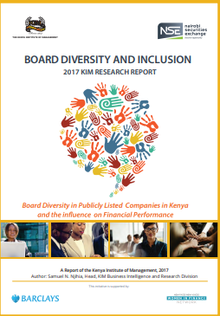
D&I practices in Kenya
In Kenya, D&I has been misconstrued to mean gender balance only. However, it is diversified to also include women, youth, people with disabilities and citizens from marginalized areas.
Various efforts have been made to ensure the political and economical spheres of the country adopt an efficient D&I measures e.g. establishing NGEC (2011)
The KHRC’s Strategic Plan (2014-2018) endeavors to enhance the inclusion and participation of marginalized groups in the public sphere, particularly in decision making.
The KIM board D&I report (2017) was an effort towards looking beyond gender into age, professional background, education level, nationality etc

Slide 15
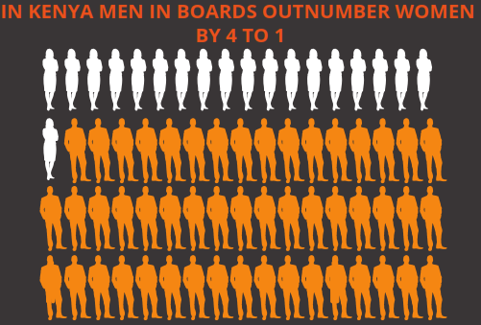
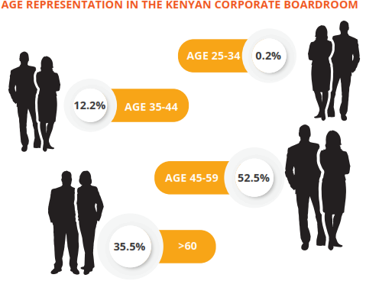
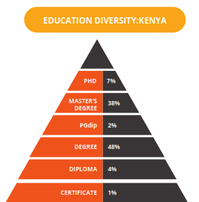
D&I in leadership and management
Kenya’s performance on D&I at board level is still far from balanced;
Gender
Age
Education
Other diversity variables are not very well researched and the scanty data available indicates low diversity in professions, education, disability, nationality and ethnicity.

Slide 16
D&I in the Kenyan Workplace
Some companies in Kenya are however doing particularly well in ensuring D&I in the workplace starting at the board level;
BAT Kenya
Barclays
Liberty Kenya Insurance
Bamburi Cement
BOC Kenya
Total Kenya
Longhorn Publishers
Standard Chartered
Safaricom

Slide 17
Why D&I at the workplace?

Slide 18

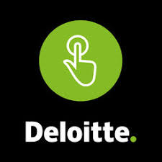
Studies suggest D&I is beneficial on organizational performance
The KIM D&I report (2017) confirmed that diversity at board level is associated to higher ROE over a 4 year period among NSE listed companies.
The report also revealed a positive correlation between age spread at the board level and profits earned by these companies over the same 4 year period.
Another study by Deloitte in 2015 showed that companies that have diversified have 2.3 times higher cash flow per employee over a three-year period than a non diversified companies.

Slide 19
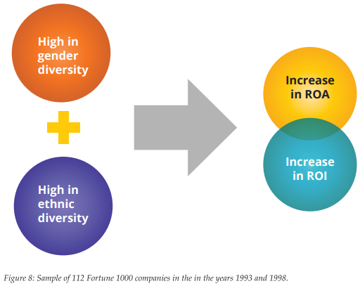
Studies suggest D&I is beneficial on organizational performance
According to 2003 study of fortune 500, there exists a positive correlation between diverse boards (gender and ethnic) and ROA together with ROI.

Slide 20
Other intangible benefits of workplace D&I would include
Benefits
New & diverse business ideas from a diverse workforce
Workforce and population diversity is in sync
Workforce representative of the local community
Improved corporate image with potential employees and customers
Diverse and inclusive environments are dynamic and energized.
Managers can integrate equality into corporate objectives
A workforce that reflects your customers.

Slide 21
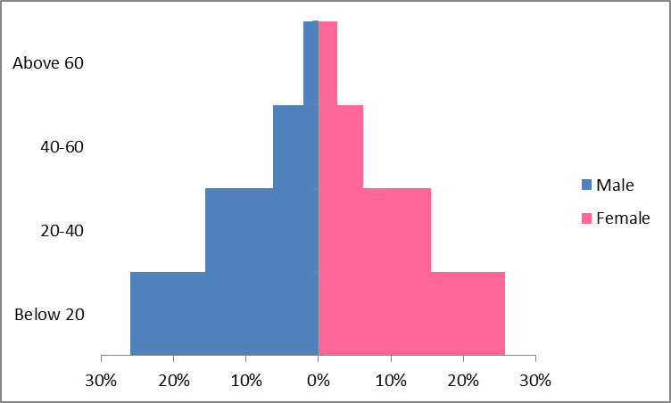
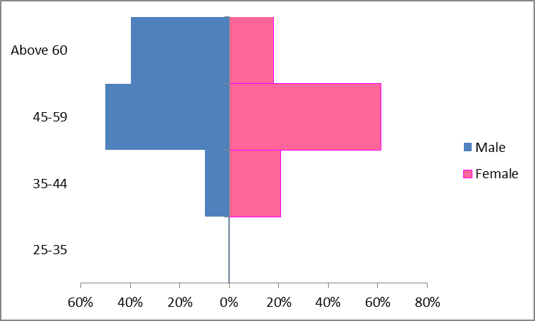
What is the way forward?
Kenya’s population 2017
Board representation by gender and age
Challenge
How can we invert the 2nd chart to reflect the 1st chart (the pyramid)?
What is the role of the CEO in facilitating D&I at the workplace? A culture?
How do we reach out to the minority & marginalized to bring them to the table?

Slide 22
