Slide 1

Developing Talent in the work place
Sean Massingham, Head of Knowledge Management

Slide 2

Agenda
About A&K
Takeaways
Development as a retention strategy?
The Virtuous Training Cycle

Slide 3
About A&K

Slide 4
A&K
A&K is generally considered the leading corporate law firm in Kenya, and is the largest full-service corporate law firm in East Africa with close to 100 lawyers. A&K has developed specialist expertise in several practice areas, including corporate and commercial law, mergers and acquisitions, private equity, energy, infrastructure, project finance, real estate, competition, capital markets, banking and finance, intellectual property, tax and dispute resolution.
A&K operates Africa-wide, handling deals in several countries across Africa, both in its own capacity and in collaboration with ALN firms across the continent.
A&K has offices in both Nairobi and Mombasa, Kenya’s two main commercial centers, providing a broad range of legal services in both.

Slide 5
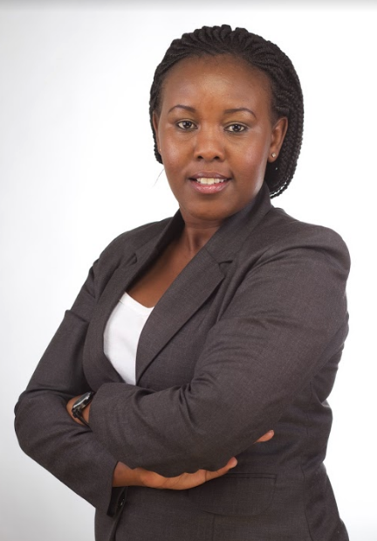
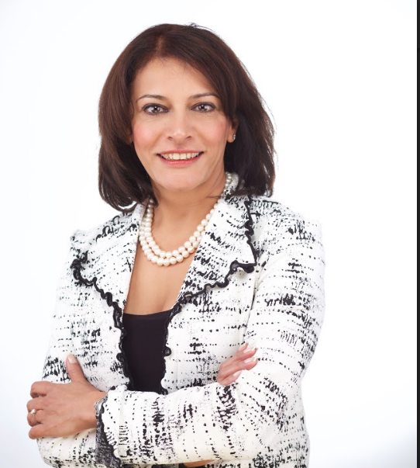

A&K Employment Experts
Faith Macharia – Okaalo
Senior Associate
Sonal Sejpal
Director
Rosa Nduati-Mutero
Partner

Slide 6
Takeaways
What? At the beginning?

Slide 7

Takeaway 1
Learning and development will only be a positive retention tool if the organisation has the rest of its employee engagement systems purring

Slide 8

Takeaway 2
Giving employees training and development opportunities should be given as much careful consideration as the decision about their bonus

Slide 9
Takeaway 3
To be successful a learning and development regime needs to:
  be a virtuous cycle of seeking input, solving problems and checking back in to determine progress
  make the recipients (and their supervisors) accountable for growing and changing in response to the training
Identify & Analyse needs
Determine & Design Solution
Deliver or Administer Learning activity
Review & Evaluate

Slide 10
Development & Retention

Slide 11

Ever heard anyone say this?
“The pay was lousy….”
  “My boss was a micromanaging slave driver….”
  “The company’s mission didn’t align with my personal values….”
  “The job was boring….”
  “…..but I stayed because of the training?”

Slide 12

Employee Retention
Notes:
Employee retention is a function of a lot of issues – we will hear more of this from the other speakers – but if you did a survey of what keeps people at firms you would get a long way down the list before you get to training.

Slide 13
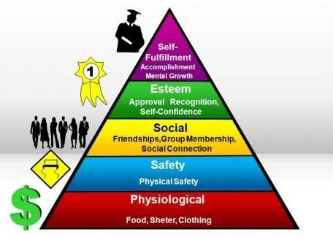
Maslow's hierarchy of needs
Notes:
Where does training/personal development fit in?
Either Esteem or Self actualisation.
Point of this slide is that there is no point in having a super development and training regime if you haven’t got the foundations of employee comfort and satisfaction established.
Need to pay them enough, provide them a good workplace, get them involved etc etc

Slide 14

Development a destabilising force?
A focus on development can, done poorly, actually result in negative retention outcomes and create team instability.

Slide 15
Really?
Pitfalls
  Lack of communication leads to the appearance of arbitrary allocations of resources
  No clear guidelines leads to jealousy of people not given opportunities.
  That’s unfair!

Slide 16
The Virtuous Training Cycle

Slide 17
The virtuous training circle
Performance appraisal
Personal Need identified
Type of development identified
Ensure their supervisor is involved
Ensure Accountability for outcomes achieved
Give the person space to learn

Slide 18

Wasted training?
Lots of training is done that is then ignored or forgotten
Why?
The recipient doesn’t accept the need for change or improvement
Notes:
Keep this in mind for the discussion of the virtuous training cycle. The steps in the cycle are meant to overcome this issue.

Slide 19
Identify the Development Needs

Slide 20
How?
Create a process to obtain this information
  Appraisals
  360’s
  Surveys of co-workers
As HR/L&D look for patterns, gaps, special needs
Ask the person!

Slide 21

Needs vs Wants
Development of people must be linked to specific needs – either theirs or the organisations.
The needs of their current job is important but only part of the full story.
The organisation should also have goals for its influencing its employee’s behaviour and expectations
Notes:
For people to change behaviour they need to accept that they need to change.
If all you are doing is training their current skill needs you will be the equivalent of the generals who are well prepared to fight the last war. They always lose to the people ready to fight the current wage.

Slide 22
Develop the plan

Slide 23
Create a logical structure
Pick relevant topics
Use great trainers – internal or external
Make the development an ‘experience’
Give people the incentive to attend – try not to make it mandatory

Slide 24

Focus on the Future
Identify your high potential employees (while avoiding the jealousy pitfalls I mentioned earlier) and train them to rise to the next level
Look at the skills your people will need in the future and start to develop those skills now

Slide 25
Include the chain of command

Slide 26

Involve employee’s supervisor
Ensure all supervisors understand that development of their people is a priority
Hopefully this is already their priority!

Slide 27

Set Clear Expectations
Make the expectation of positive change and development explicit on attendees
Ensure the supervisor understands what the training is meant to achieve so they can focus and reinforce the messages

Slide 28
Train the leaders
Senior people often believe training is something their team needs – not themselves
Convince the supervisor that they need growth and development too!
People seeing their boss acknowledging the need to change and grow is very powerful

Slide 29
Give the person space

Slide 30
Get them focussed
Give the attendee space to be present
  No work requirements hanging over their head – treat this like holidays
  No technology – remove laptops (and maybe even phones) from people when entering the room
Determine whether in office or out of office – each has its benefits

Slide 31

Challenge them!
Give the attendees the challenge to manifest evidence of their development or what they have learned to their colleagues and supervisors

Slide 32
Accountability

Slide 33

Create an accountability process
Need a process in place to:
  Let the person’s supervisor know that the employee is being trained and what the purpose of the training is
  Ensure that the employee knows that their supervisor knows.
  Involve the supervisor in post training reflection and exercises to embed the knowledge obtained or change suggested

Slide 34

Make people care about outcomes
Link the employees successful development/requirement to change behaviour to the bonus of both supervisor and employee
Check in the employee development progress at the start of the following year

Slide 35

Questions?

Slide 36
BOTSWANA | ETHIOPIA | KENYA | MADAGASCAR | MALAWI | MAURITIUS | MOZAMBIQUE | NIGERIA | RWANDA | SUDAN | TANZANIA | UGANDA | ZAMBIA
ASSOCIATE FIRM IN SOUTH AFRICA | REGIONAL OFFICE IN UAE
Sean Massingham, Head of Knowledge Management and Performance Improvement
T +254 (0) 20 364 0 331
E mst@africalegalnetwork.com
NAIROBI
Anjarwalla & Khanna
The Oval, 3rd Floor
Junction of Ring Road Parklands and Jalaram Road
PO Box 200-00606, Sarit Centre, Nairobi, Kenya
T +254 (0) 20 364 0000, + 254 (0) 703 032 000
E info@africalegalnetwork.com
W: www.africalegalnetwork.com
MOMBASA
Anjarwalla & Khanna
SKA House, Dedan Kimathi Avenue
PO Box 83156 – 80100, Mombasa, Kenya
T +254 41 2225090/6
E mba@africalegalnetwork.com

