Slide 1


1
How to Maintain Exemplary
Work Culture
By Shadrack Kirui
Interim Group HR Advisor – Bonfide Group

Slide 2
Content
Introduction
What is culture?
Determinants of culture - discussion
Can culture be measured ? discussion
Importance of Organizational Culture
6.Maintaining exemplary work culture
Question and Answer
Closure
1

Slide 3
2

Slide 4
3
Contents
Introduction
Warren Buffett said, “It takes 20 years to build a reputation and five minutes to ruin it.”
Many organizations struggle to create a memorable and magnetic workplace culture, and it’s no wonder. Culture is tricky to define, and takes time and effort to build.
One thing is clear: strong organizational culture is a Powerful talent attractor. It can win you access to the best talent in your industry and be the glue that retains top employees amid fierce competition.
So how can you turn your culture into one of your strongest assets?

Slide 5
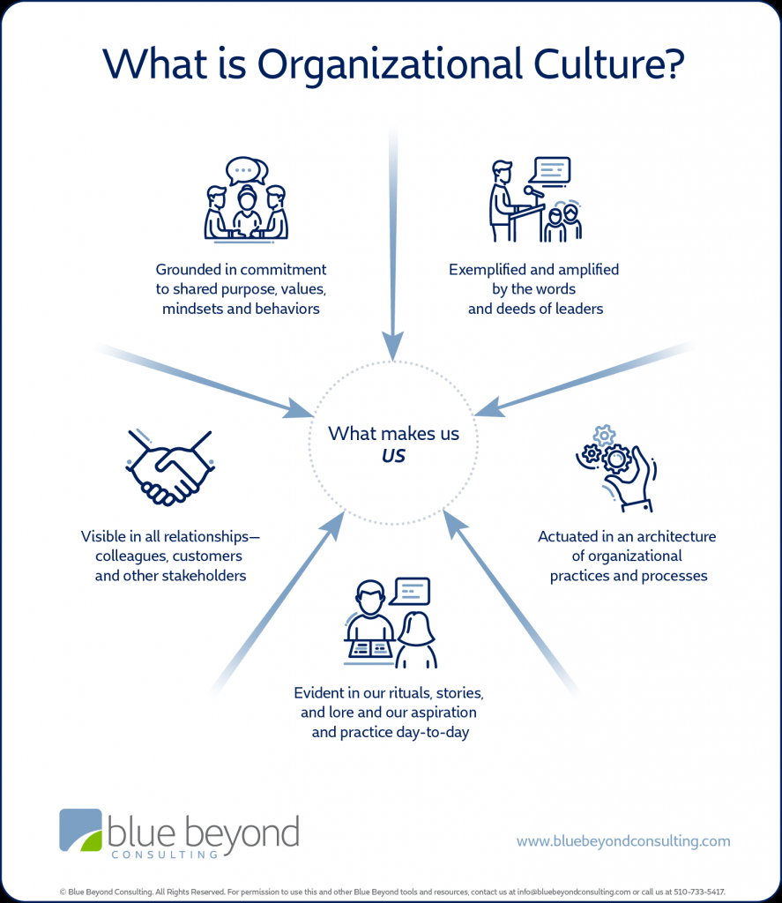
3
Contents
Introduction

Slide 6
2
Measure of Organizational Culture

Slide 7
3
Contents
Measures of Organizational Culture
Can organizational culture be measured?

Slide 8
2
Importance of organizational culture

Slide 9
3
Contents
Importance of organizational culture
It defines your company’s internal and external identity,
Organizational culture is about living your company’s core values,
Your culture can transform employees into advocates (or critics),
A strong organizational culture helps you keep your best people and forms a positive external attraction,
Transforms your company into a team and impacts on the bottom line,
It impacts performance and employee wellbeing generally fostering employee engagement.

Slide 10
2
Business Strategy Culture Operating Model

Slide 11
3
Business Strategy , Culture & Operating Model
Contents
Strategy
Culture
Ops model

Slide 12
2
Maintaining Exemplary Work Culture

Slide 13
3
Contents
Maintaining Exemplary Work Culture
Prioritize transparency. Employees that feel included and in the loop on important decisions are motivated to be more engaged and do their best work. Transparency is the #1 factor contributing to employee happiness;
Articulate the company’s shared vision and align everyone on big goals. (Top-down alignment on mission, values and purpose) Since the profiles of the incoming employee populations suggests a need to have an impact—Generation X employees “do it their way” and Gen Y workers want recognition for their “part shared vision is then vital;

Slide 14
3
Contents
Maintaining Exemplary Work Culture (Cont’d)
Recognition and belief in the mission and vision by the top leaders who establish outcomes and midpoint goals with concrete objectives, as well apply measures to evaluate the success of those goals;
Make people feel like they belong. Feelings of safety, belonging and mattering in employees improves communication, collaboration and alignment, which ultimately boosts company revenue and service delivery;

Slide 15
3
Maintaining Exemplary Work Culture (Cont’d)
Contents
Hire for cultural fits. A 2005 study showed strong culture fit can mean greater job satisfaction, stronger identification with a company, longer tenure, more commitment, and superior performance. Start by defining the key tenets of your organizational culture. Then integrate these criteria into your employer brand messaging, job content and interview processes;
Have teams that are positively challenging one another. Have a demand for excellence in essence delivering the best in all [we can] do, and we’re very focused on that service.”;

Slide 16
3
Maintaining Exemplary Work Culture (Cont’d)
Contents
Adhere to the concept of diversity “Connecting with one another and understanding the differences in each of our teams, appreciating them, and respecting them and take into consideration a variety of opinions
Have Employee Wellness at the core as an EVP
Continuously align support systems to reinforce the desired culture (e.g., performance management, talent management, training, recognition, etc.)
Positive reinforcements ……. Accolades never hurt

Slide 17
2
Conclusion

Slide 18
3
Contents
Conclusion
Leaders cannot create and maintain positive work culture alone—they must provide the necessary conditions for sustaining momentum;
This includes providing resources (financial and human resources, support systems, including a network of people), identifying competencies (new knowledge, skills and behavior required for future cultural success) and establishing reinforcing behaviors;
Transforming the current culture to the new or desired culture will always create tension and dissonance
Exemplary work culture leads to HPOs

Slide 19
2
What Can HR Practitioners do

Slide 20
Contents
What Can HR Practitioners do
Undertake periodic culture audits
Initiate employee engagement /opinion surveys and action plans and periodic HR dipsticks
Facilitate staff engagement sessions and have cross functional learnings
Optimize technology – Webinars, Zoom links, Skype and review what AI portends for the future
Model a positive culture. Align all HR services to support a positive culture (staffing, employee development, employee relations, and reward)

Slide 21
2
Q & A
Thank you!

Slide 22
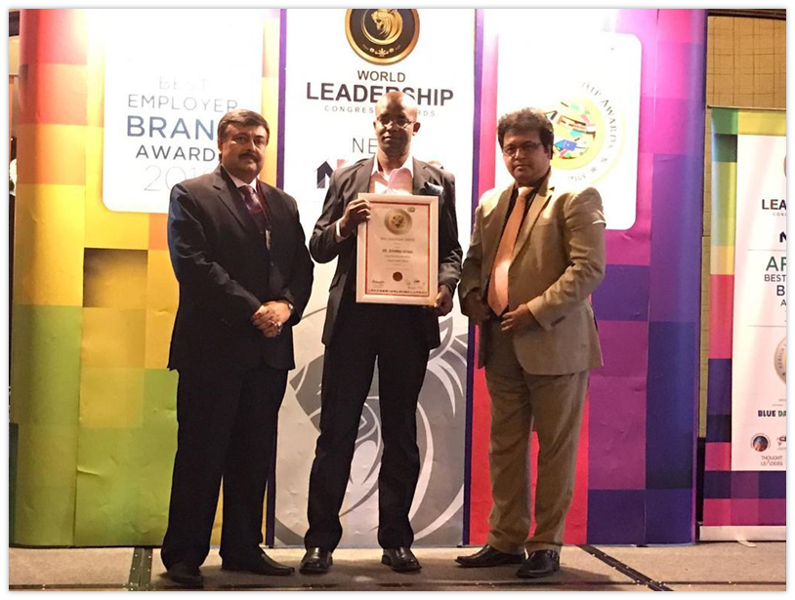
Employer Brand Awards 2016 Recipient & 2017 Nominee – World Leadership Congress Mauritius

Slide 23
2
Shadrack Kirui
Interim Group HR Advisor – Bonfide Group
Contact:
+254722889238…
Email: shaddie.kirui@gmail.com

