Slide 1



Talent Acquisition -
How to minimise the risk of hiring a non performer
Fit For Purpose Solutions
www.tatcafrica.com

Slide 2



Ensuring the person you interviewed, is the person you hire
You interviewed this
But got this

Slide 3
Ensuring the person you hired is the person you interviewed
The first point of contact : the C.V.

Slide 4



Ensuring the person you hired is the person you interviewed
A C.V. is the best advert anybody can write about themselves
It usually covers enough to get them through the initial screening
The C.V. may / or may not be well presented - but if the content of experience looks good:
People ‘fudge’ some areas of expertise
They change dates - to hide gaps in their employment

Slide 5


Ensuring the person you interviewed, is the person you hire
The first step in finding out “who they are” is the interview
...Which most people are nervous about

Slide 6
Ensuring the person you hired, is the person you interviewed
The Interview

Slide 7

Origins of interviewing

Slide 8
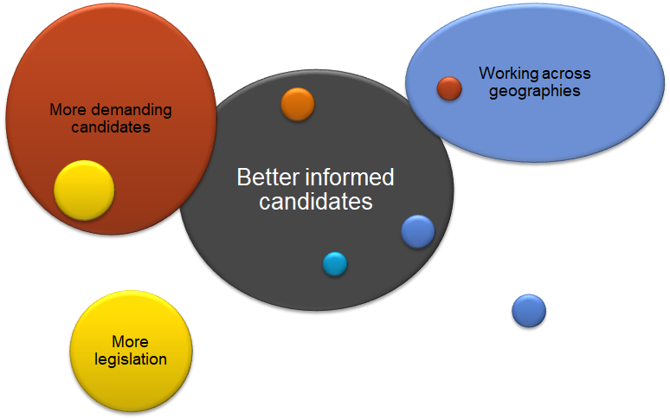
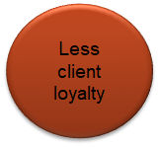
Interviewing - Complexity in which we work

Slide 9
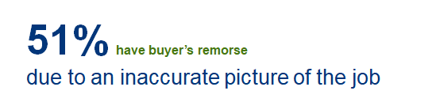

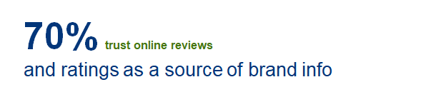

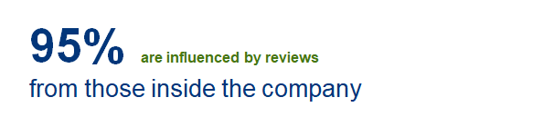
Candidates are like consumers

Slide 10
Why do we interview?
Goal of the interview?
To identify the skills and attributes the candidate brings to the job
To see how well they will fit into the organization
Sell your companies value proposition

Slide 11
It works both ways
Don’t forget - The candidate is also interviewing you
The informed candidate today, is also interviewing you, and your organisation to see if they can work in your company environment.
Culture - job training - career advancement is top of mind for most candidates today.

Slide 12

The battle between H.R. and Line Management
I often see the process go wrong at this point
Line Managers need the resource
H.R. Facilitates the process
BUT
Line Managers, in most cases, do not know how
to interview effectively - and often, when the
candidate does make the “‘cut’’ once on board
The blame is placed at H.R.’s door

Slide 13
The battle between H.R. and Line Management
Critical to consider is the training of your
Hiring Managers on how to interview effectively

Slide 14



Let’s have some fun
Imagine - you had one hour to meet and
assess your future husband or wife
What questions would you
Ask to make an informed
decision?

Slide 15

Cost of getting it wrong
The stakes are high when you’re recruiting. The industry rule of thumb is: the wrong person costs you three times his or her annual salary.
potential customers and momentum. And you’re back to square one,

Slide 16
Interesting research
A recent study conducted about the interview process showed that:
·96% of job seekers regard the personalities of interviewers as having either a strong or some influence on their decision to accept a job offer
·72% of professionals are put off by a lengthy recruitment process
·99% jobs seekers expect feedback on their interview within seven days
“80% of employee turnover is due to bad hiring decisions.” – The Harvard Business Review.

Slide 17
Interesting research
A bad interview process reflects very poorly on your brand.
Not only will the candidate have a bad impression of your organisation, but will very likely mention this to many people. The multiplier effect means this could have serious consequences.

Slide 18

Do you remember?
Do you remember a bad interview experience when you went for an interview?
Chances are - you don’t remember the interviewers name - but you most certainly do remember the brand

Slide 19

Prepare for the interview
Read the C.V.
Know the questions you want to ask
The time spent here is essential

Slide 20

The time spent here is essential
Take your time -
It’s the golden hour or opportunity

Slide 21
What you should not be asking - adds no value
Question 1: “So, I see you got married recently. When are you planning to start a family?”
Question 2: “How do you deal with stress?”
Question 3: “How old were you when you graduated?”

Slide 22

So how do we get it right?
A degree is not a measure of whether a person can do the job
High performers share common threads, and it is not degrees
Neither is it time served within an organisation
It is behaviour / attitude that dictates performance

Slide 23
So how do we get it right?
A great employee doesn't just fill a slot on the org chart. A great employee solves at least one critical business need.
You’re hiring for a result.
You don’t need a Sales Director; you need someone who will sell.
You don’t need a Head of Ops; you need someone who can produce on time.
Otherwise you’re just wasting your time.

Slide 24

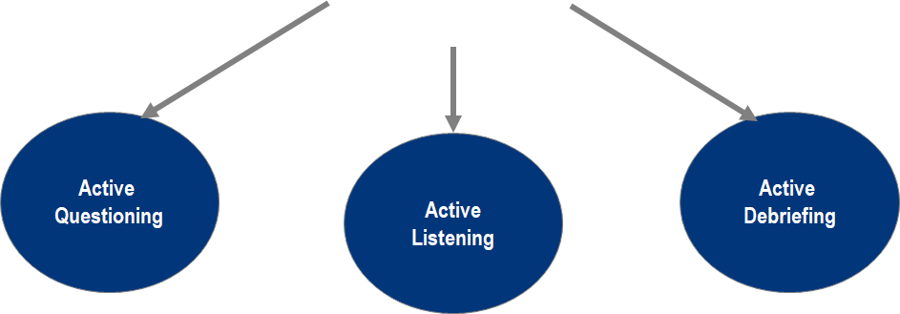
Uncovering the mystery
Competency based Interviews
Behaviour

Slide 25
So what am I looking at asking?
S | The Situation or context of the task
T | The Task that has been commissioned
A | The Action taken to achieve the task
R | The Result or outcome of the action

Slide 26
Example of the types of questions
There are a variety of behavioural based questions available per level
You are essentially wanting the candidate to tell you a story
Things rarely go according to plan
Tell me about a time that you were in the middle of executing a plan / project and the resources to achieve this were reduced.
What did you do?
What was the outcome?
Building partnerships is often difficult (statement)
Describe a partnership that was the most difficult to develop
What obstacles did you encounter?
How did you overcome them?
Stressful situations often cause increased emotion (statement)
Tell me about the most stressful situation you ever had at work.
How did you handle the pressure?
How did the stress impact your ability to deliver

Slide 27
Ensuring the person you hired is the person you interviewed
Assessments

Slide 28
Assessments
Assessments should only be done on the 2 -3 shortlisted candidates to ensure that you make the correct hiring decision.
Practical outputs are best - to measure actual abilities (and behavioural attributes) as these are the deciding factors for superior performance
Using our superior tech driven assessment centre, we are able to identify the following, from one simple assessment.
This assessment approach, is backed by 30 years of research - can be used when hiring, or if you are wanting to assess your current staff to identify developmental needs.

Slide 29




Harvard Business Review : 5 Distinctive areas of sales
Relationship Builders
Focus on developing strong personal and professional relationships and advocates across the customer organization. They are generous with their time, strive to meet customers’ every need, and work hard to resolve tensions in the commercial relationship
Hard Workers
Show up early, stay late and always go the extra mile. They will make more calls in an hour and conduct more visits in a week than anyone else within the team
Lone Wolves
Are deeply self-confident, the rule breaking cowboys of the sales force, who do things their way or not at all
Reactive Problem Solvers
From the client’s standpoint, highly reliable and detail oriented. They focus on post-sales follow-up, ensuring that service issues relationed to either implementation and or execution are addressed quickly and resolved

Slide 30

Of the 5 - the biggest differentiator
Challengers dramatically outperform the other profiles, particularly Relationship Builders - Why?
Challengers teach their customers. They focus the sales conversation not on features and benefits but on insight, bringing an unique perspective on the customer’s business. They come to the table with new ideas for their customers that can make money or save money — often opportunities the customer hadn’t realized even existed.
Challengers tailor their sales message to the customer. They have a finely tuned sense of individual customer objectives and value drivers and use this knowledge to effectively position their sales pitch to different types of customer stakeholders within the organization.
Challengers take control of the sale. While not aggressive, they are certainly assertive. They are comfortable with tension and are unlikely to give in to every customer demand. When necessary, they can press customers a bit — not just in terms of their thinking but around things like price.
Challengers
Use their deep understanding of the clients’ business to push their thinking
and take control of the sales conversation. They are not afraid to share even potentially controversial views and are assertive -
with both their clients and bosses

Slide 31

Let’s consider hiring of effective sales people
An excerpt from the Harvard Business Review research undertaken on what makes good sales people in today’s complex world of selling
“To understand what sets apart this special group of sales reps, the Sales Executive Council launched a global study of sales rep productivity three years ago involving more than 6,000 reps across nearly 100 companies in multiple Industries”
The data sample revealed that
Challengers absolutely dominate as selling gets more complex.
54% of all star reps in a solution-selling environment are Challengers.
At the same time, Relationship Builders fall off the map almost entirely, representing only 4% of high-performing reps in complex environments.
Additional research also revealed that top performing salespeople can outperform your average sales person by up to 12x

Slide 32
The outcomes for you - Looking at Sales Ability
1. Face to face selling
2. Stages of relationship selling
3. Managing the challenges of working in sales

Slide 33
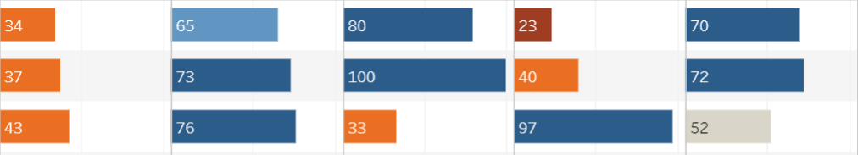

Face to face sales - the 5 areas as per Harvard Business Review
Mary A
Mary B
Mary C

Slide 34
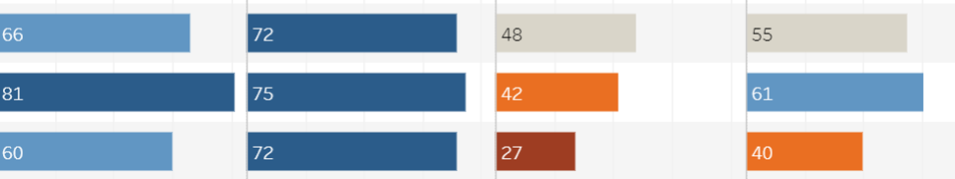
Stages of relationship selling
Mary A
Mary B
Mary C

Slide 35
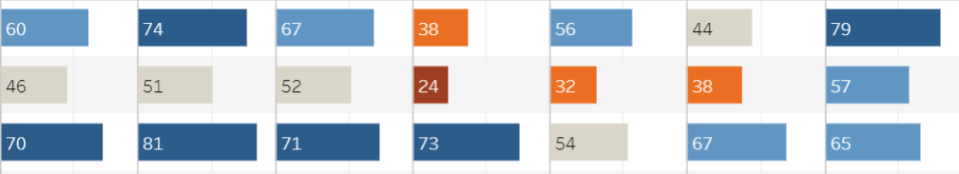
Managing the challenges of working in sales
Mary A
Mary B
Mary C

Slide 36
Management Performance
Management is the toughest job of all - we need to identify certain straights first

Slide 37

Management ability
Can they lead and create high performing teams?
Can they deliver work against tight deadlines?
Can they follow policies and procedures?
Are they capable of improving quality of the teams output?

Slide 38

Management ability
Are they capable of motivating a team?
Can they set clear directions for the team ?
Are they able to stay customer / market focused?
Are they able to work together across other functions to achieve goals / objectives?

Slide 39
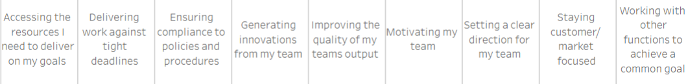
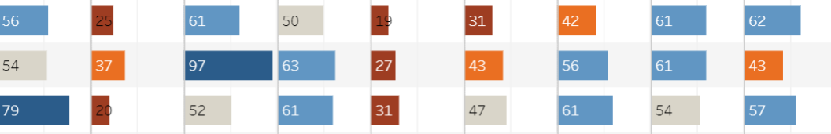
Management ability
Mary A
Mary B
Mary C

Slide 40

In addition
Can they deliver high levels of customer service?
Can they deliver work on time?
Do they have a high level of personal drive?
Can they produce high quality of work?

Slide 41
Home Stretch
The next area is critical in ensuring your new hire lands well in your organisation.
Having done all this work up to this point - many companies fail at getting the new hire settled into the organisation effectively -
which may lead to lack of performance, and the candidate may in fact, leave.

Slide 42
Home Stretch - Nearly there
Onboarding and Induction
You have followed everything - done the interviews correctly - done the assessments, and found your ideal candidate.
If you get the induction and onboarding incorrect, you will have lost them in the first 3 months - then they will never fully integrate into your organisation, and just bide their time, until something else comes along.
It is critical that this is done correctly to ensure that they settle into the new role quickly and become productive

Slide 43
Ensuring the person you hired, is the person you interviewed
Onboarding and Induction

Slide 44


Onboarding your staff
Onboarding facilitates the effective entry of a new hire into the organisation
This can be either an internal transfer or an external appointment.
It includes the technical onboarding elements for an external hire, such as
Getting them onto payroll
FIling in all the regulatory forms that are required
Ensuring they have signed all the terms and conditions of their employment etc.

Slide 45


Induction - Integrating new staff effectively
Where to find relevant information
What systems are to be used (leave / payslips other systems)
Even Parking (or lack thereof)
Welcoming new staff to the department (people)
Perhaps have a “buddy’’ in the department to help them settle in
Information they will need to become productive as quickly as possible
Introduction to the values and culture

Slide 46
Induction - Integrating new staff effectively
How would YOU feel if ?
On your first day, your computer has not arrived, your chair is broken, and your manager is not in the office
When you ask your new colleagues a question, they're often too busy to help.
As a result, you begin to feel like a burden and will become increasingly isolated, unmotivated and unhappy.
You have effectively ‘’lost your new hire’’ - as this sours the company brand experience from day 1

Slide 47
New Hires
Do you remember what your first few days / weeks were like in your new organisation?
Notes:
Include data around:
Our coverage (consider using map of Africa)
Position closed for clients
User Database: 10m
100+ Tier employers for HR advisory / executive search & collection

Slide 48

What new hires feel like - let us not forget
Notes:
Include data around:
Our coverage (consider using map of Africa)
Position closed for clients
User Database: 10m
100+ Tier employers for HR advisory / executive search & collection

Slide 49


First 3 months - critical
If induction is not done correctly, the first 3 months are the most dangerous, when your new hire may feel like this -
Working methods used in “my old company’’ don’t work here
New companies systems are outdated and frustrating
No emotional support - new people and different environment
Leads to frustration, anger and depression
Stress, Anxiety and confusion
They feel lost and out of place
Begin to think “I have made a mistake…’’

Slide 50
In conclusion
Each process has its merit.
Each part of the process is equally important

Slide 51
Ensuring the person you interviewed, is the person you hire
You interviewed this
Follow the areas that impact, to ensure you get this!

